Slide 1
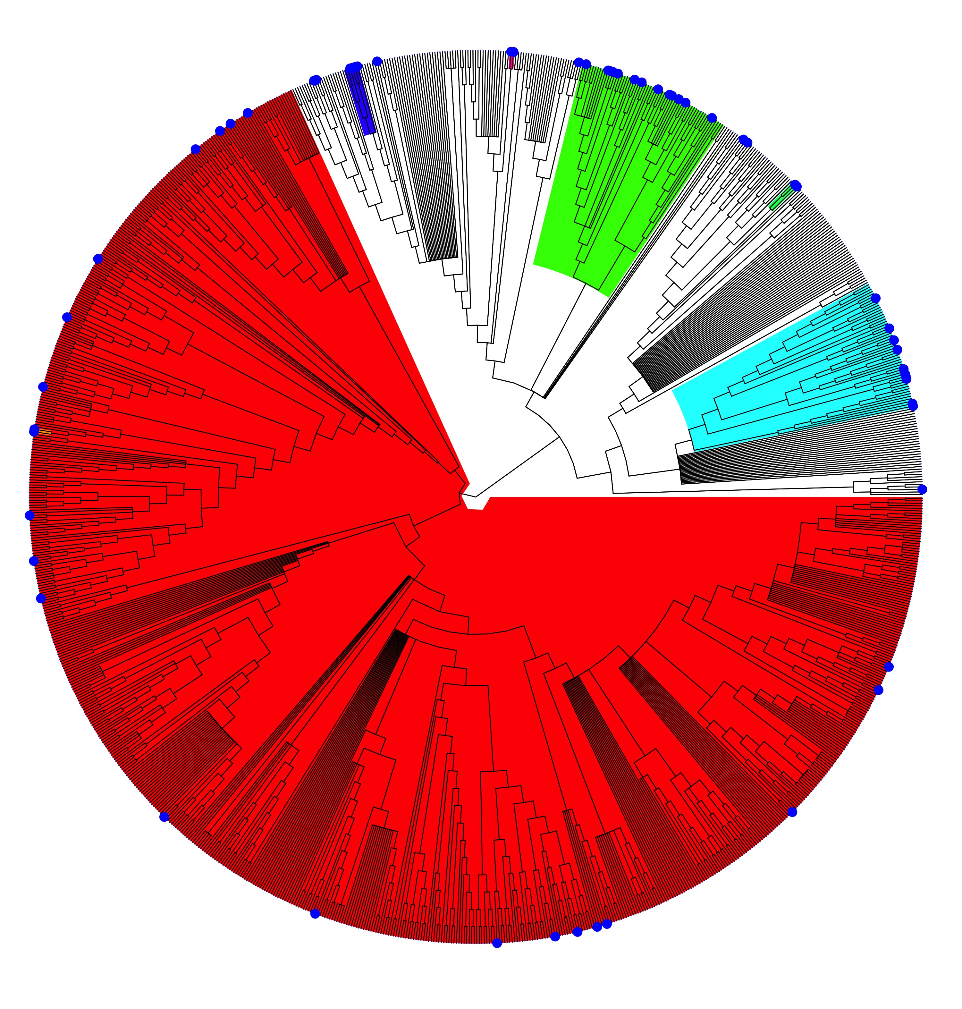
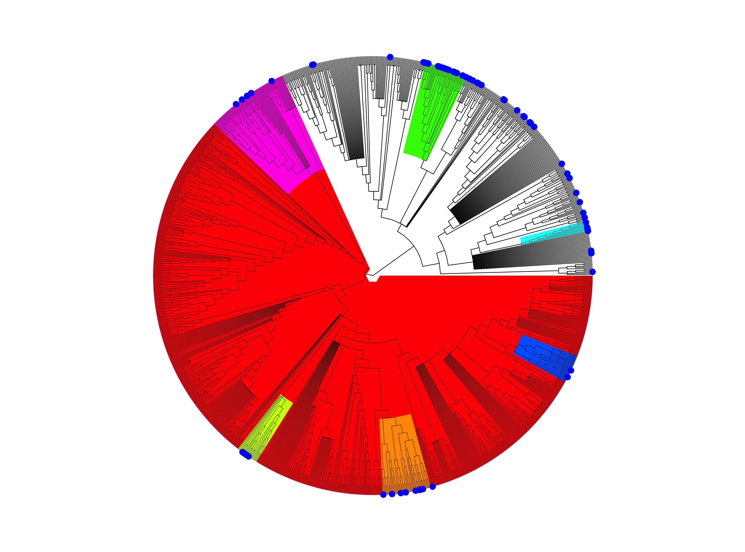
Sampled
Ab or PCR Positive
Yangochiroptera | p=0.027
Carollia | p=1
Pteropus | p=0.67
Pteropodidae | p=0.21
Rhinolophus | p=0.19
Eidolon | p=1
Hipposideros | p=0.67
Henipavirus
Pteropodidae | p=1
(Macroglossinae & Pteropodinae)
Yangochiroptera | p=0
Myotis | p=0.21
Miniopterus | p=0.28
Pteropodidae | p=0.4
Emballonuroidea | p=0.075
Rhinolophus | p=0.56
Pipistrellini | p=0.087
Filovirus
Pteropodidae | p=.9
(Megaloglossus, Myonycteris, & Rousettus)
Phylofactorization of the full bat phylogeny.
Sampled: Clade specific analysis of the proportion of bats sampled for either Henipavirus or Filovirus.
Ab or PCR Positive: Proportion of sampled bat species that have had a reported positive sample via PCR or serology.

Slide 2
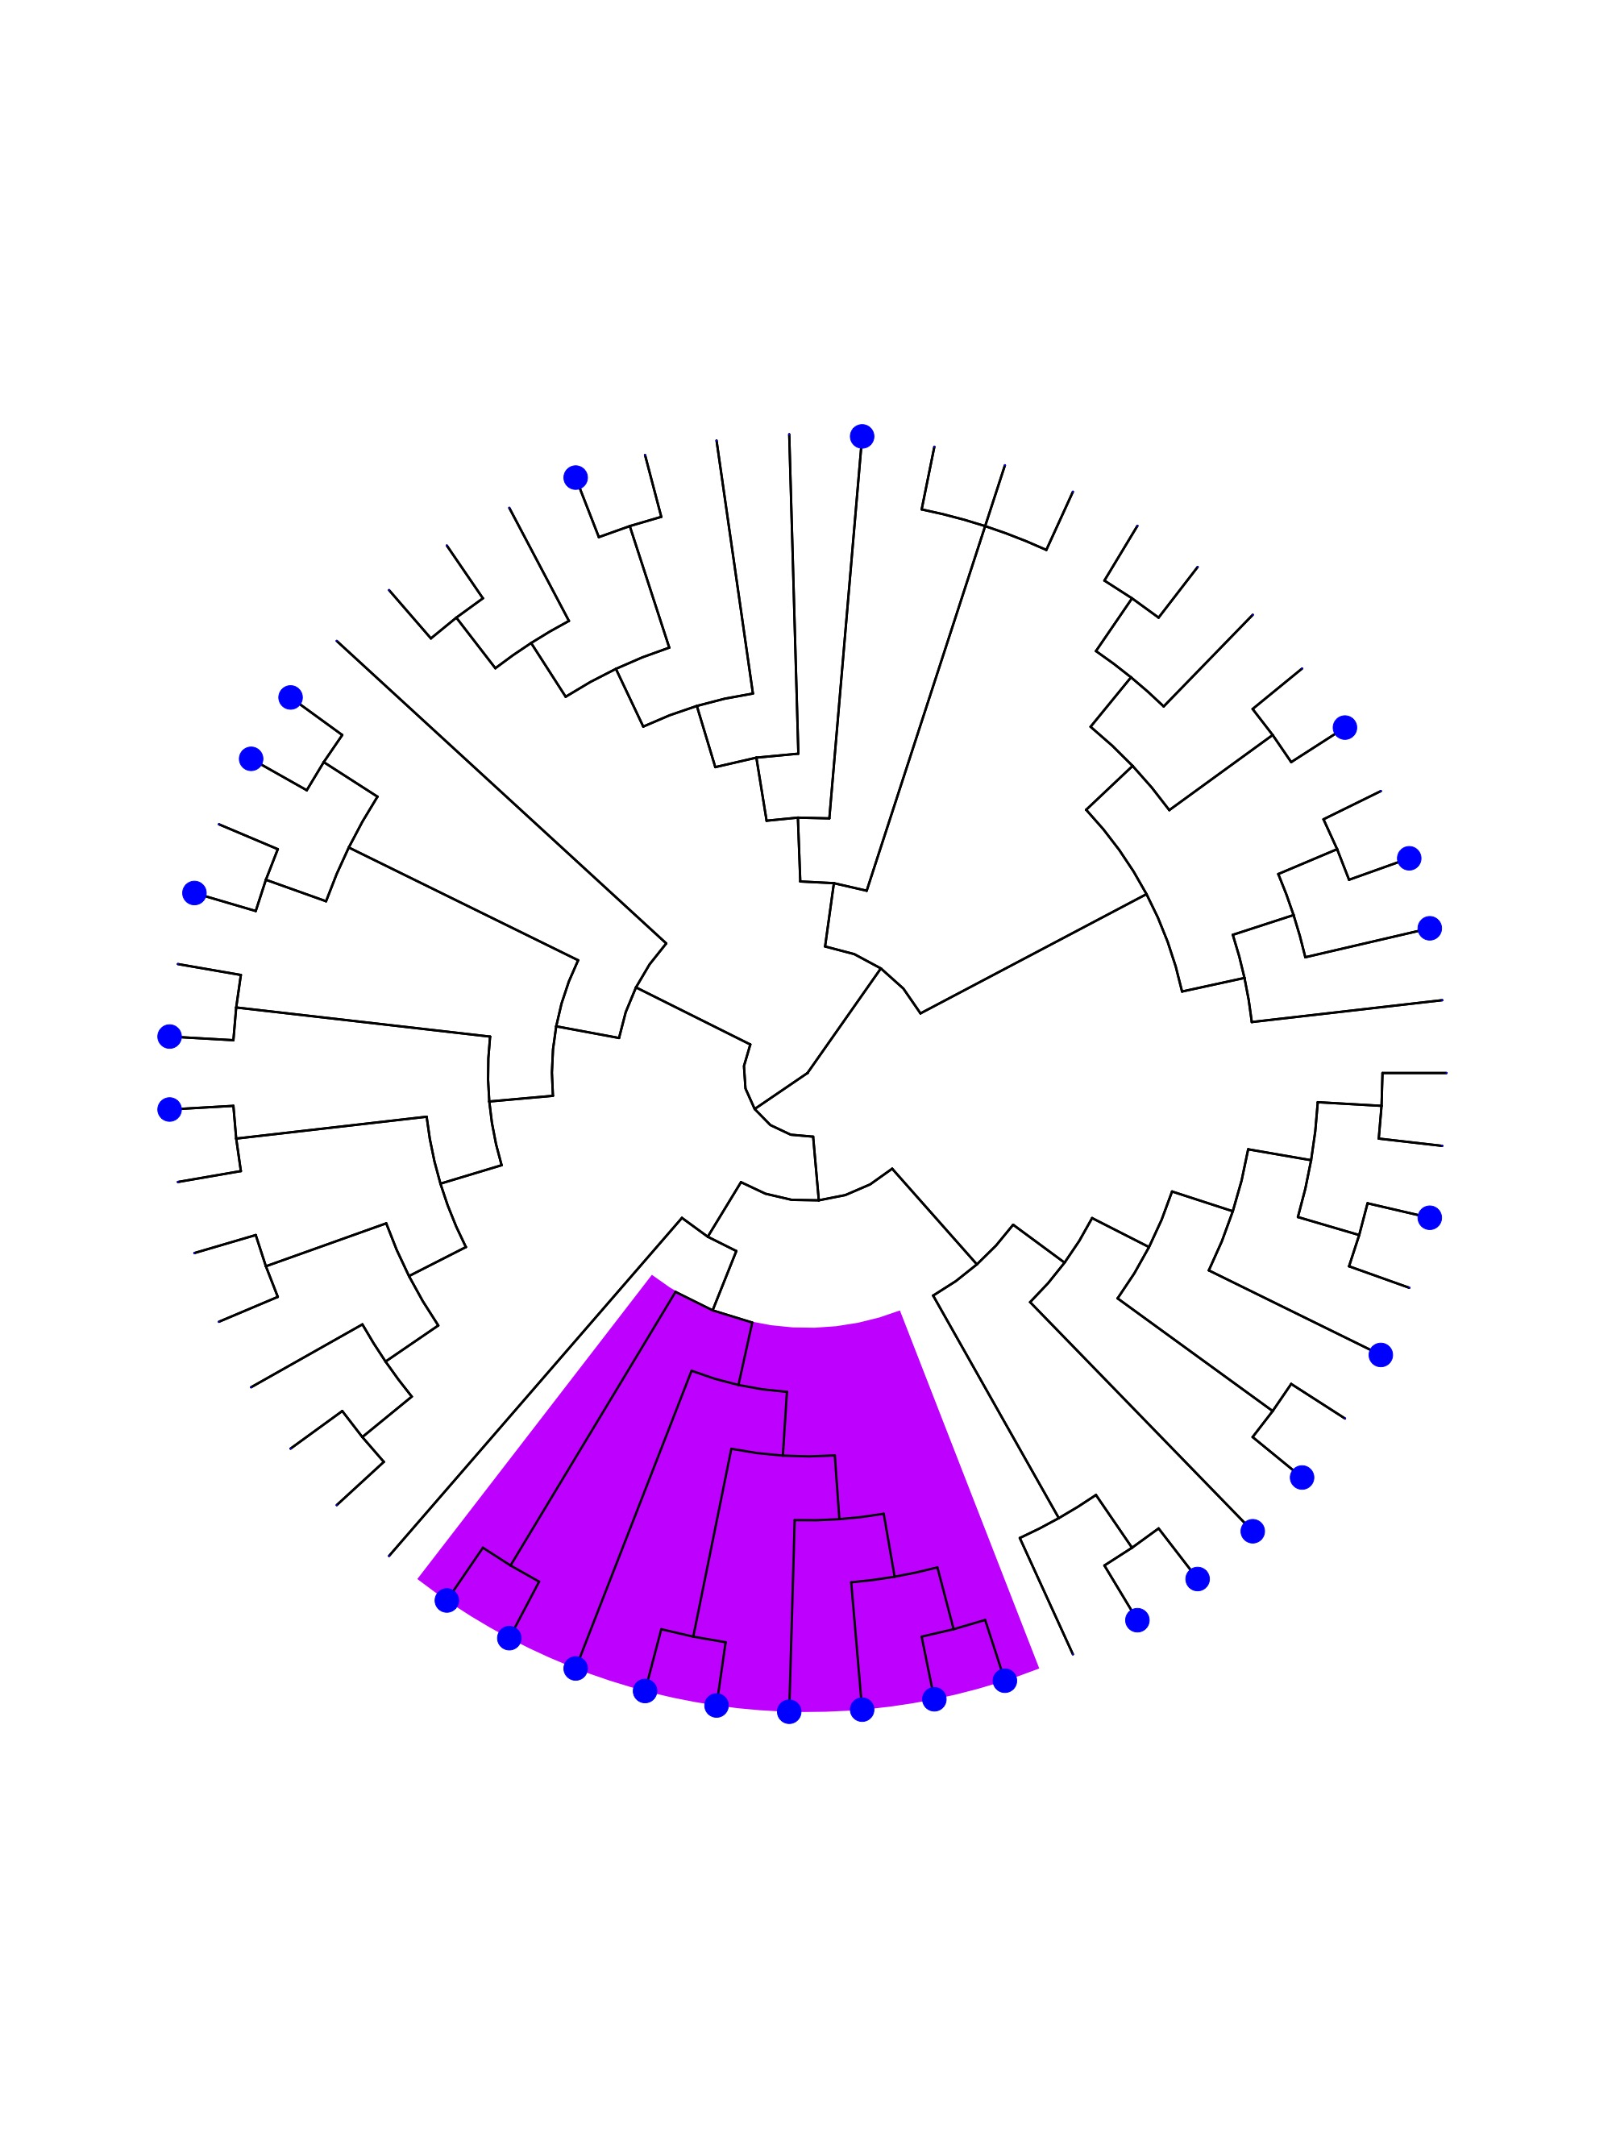
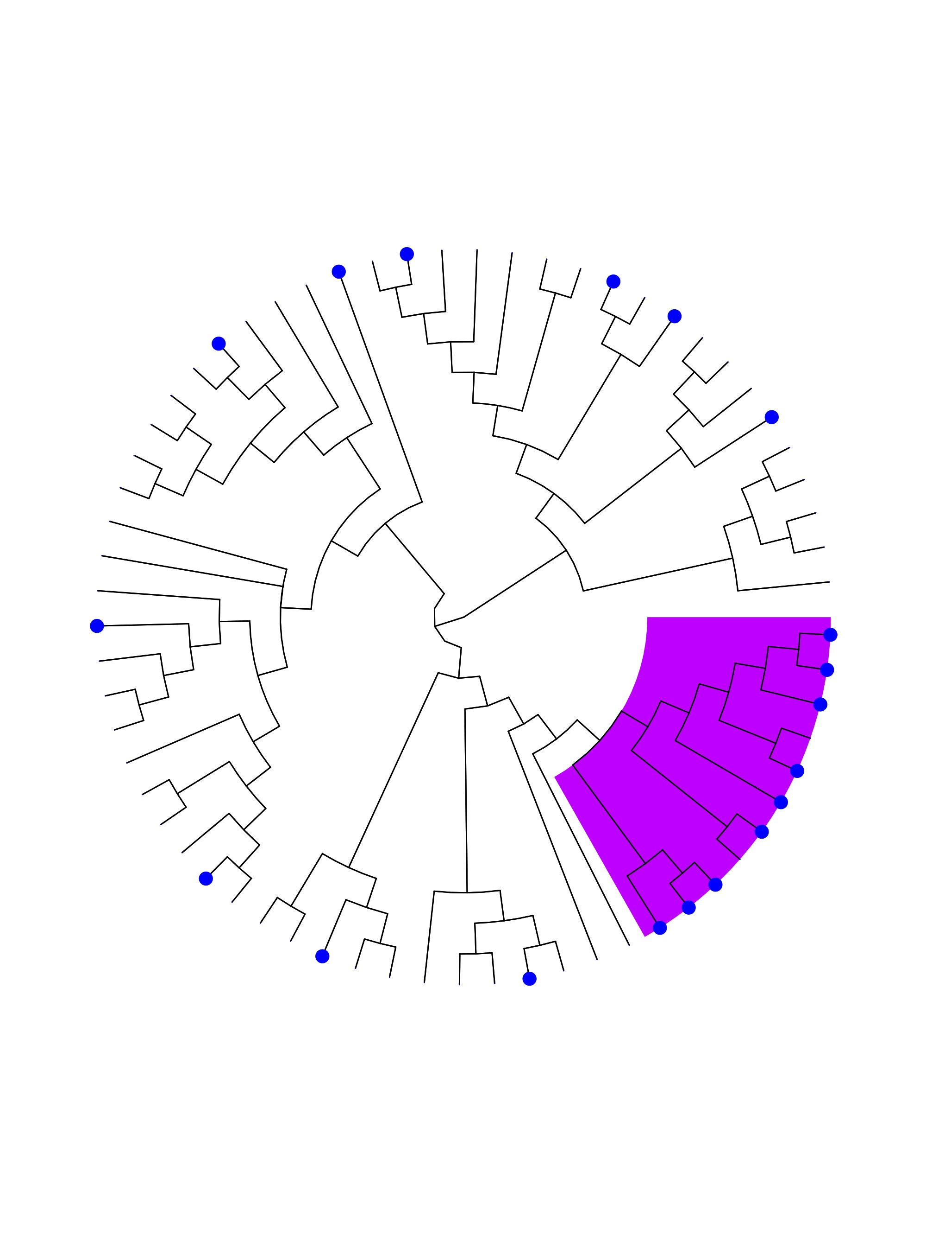
Ab or PCR Positive
Ab or PCR Positive (Controlling for Sampling Effort)
Henipavirus
Filovirus
Phylofactorization of the full bat phylogeny.
Sampled: Clade specific analysis of the proportion of bats sampled for either Henipavirus or Filovirus.
Ab or PCR Positive: Proportion of sampled bat species that have had a reported positive sample via PCR or serology.

Slide 3
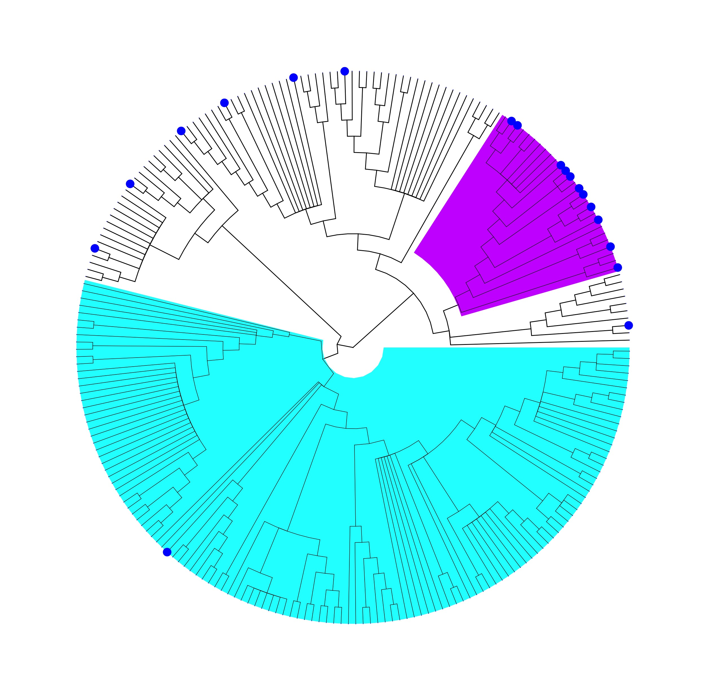
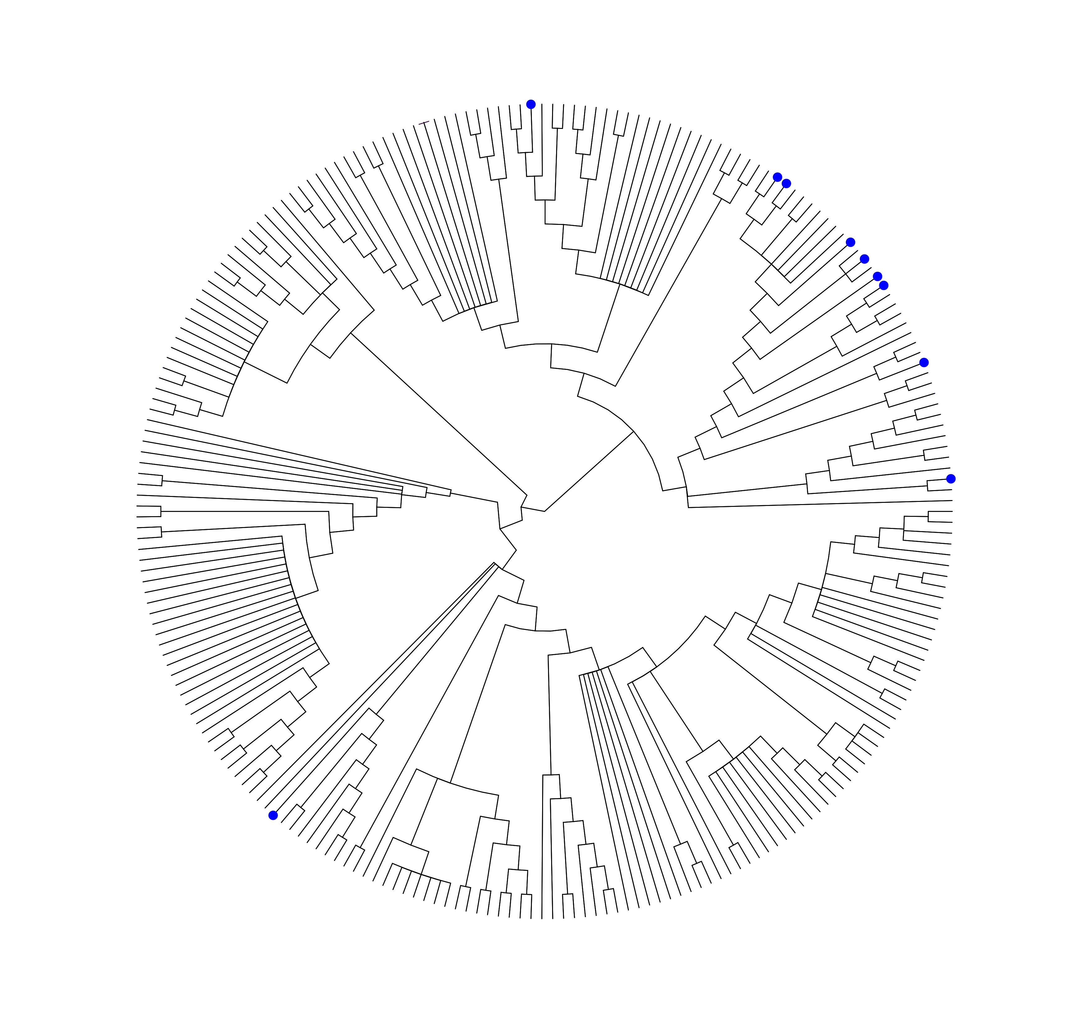
Sampled
Ab or PCR Positive
Pteropodidae | p=0.41
(Pteropodinae & Macroglossinae)
Vespertilionoidea | P=.001
Filovirus
Phylofactorization of the African bat phylogeny.
Sampled: Clade specific analysis of the proportion of African bats sampled for Filoviruses.
Ab or PCR Positive: Proportion of sampled African bat species that have had a reported positive sample via PCR or serology.

Slide 4
A
Fig XX. Sampling & Reporting Strategy
A. A schematic displaying a theoretical change in seroprevalence over the course of a year. Colored regions represent sampling schemes present in filovirus/henipavirus literature. B. Breakdown of sampling schemes present in literature. Includes mean time (in days) and standard deviation over which studies pooled multiple sampling events into single estimate.
B

Slide 5
A
Fig XX. Sampling & Reporting Strategy
A. A schematic displaying a theoretical change in seroprevalence over the course of a year. Colored regions represent sampling schemes present in filovirus/henipavirus literature. B. Breakdown of sampling schemes present in literature. Includes mean time (in days) and standard deviation over which studies pooled multiple sampling events into single estimate.
B

